Slide 1
TESLA
Contributors: Shahiq, TalLY, Jon

Slide 2
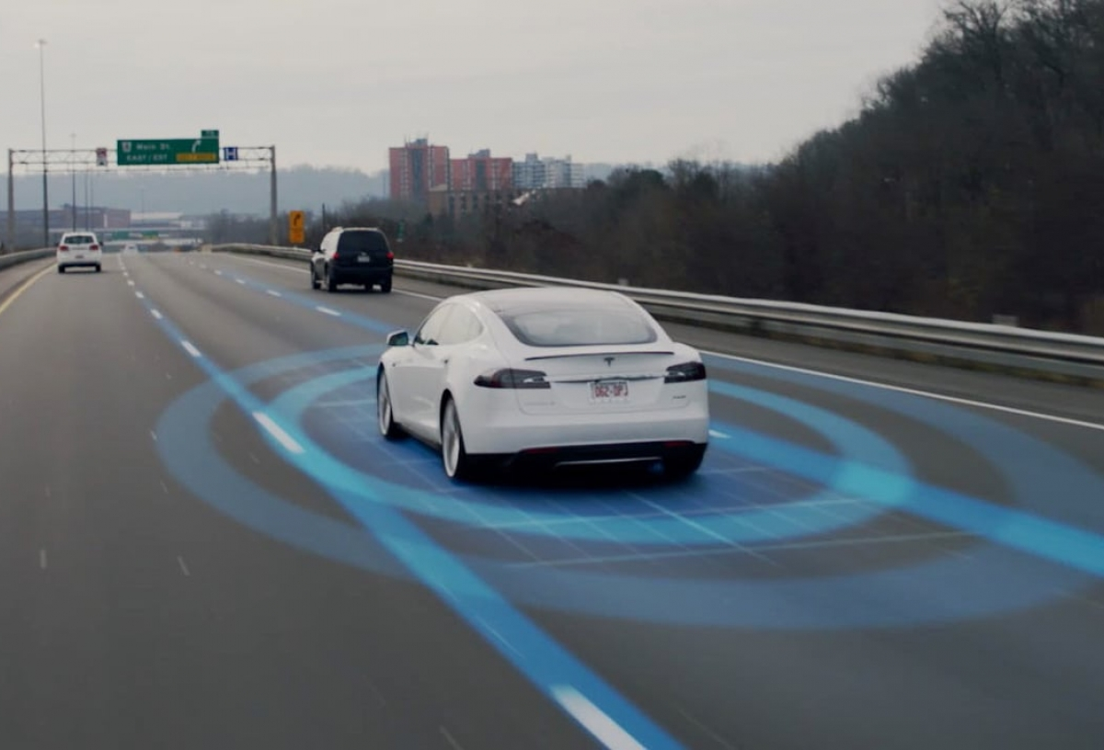
TASKS AT HAND
DETECT LANES FROM THE ROAD SURFACE
ENSURE SAFETY (BY ACHIEVING MAXIMUM ACCURACY)
DEVELOP A PROGRAM WHICH CAN DETECT LANES FROM A VIDEO

Slide 3
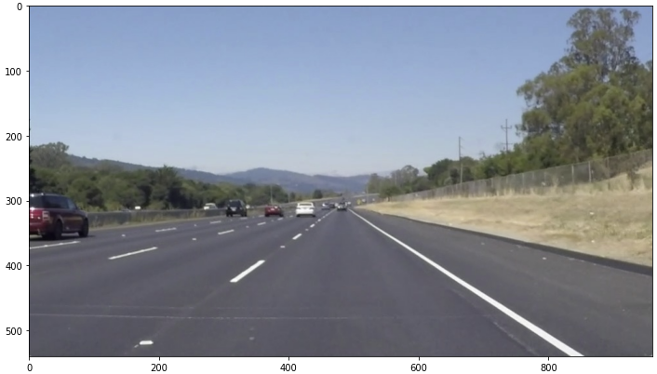
PRE-PROCESSing

Slide 4
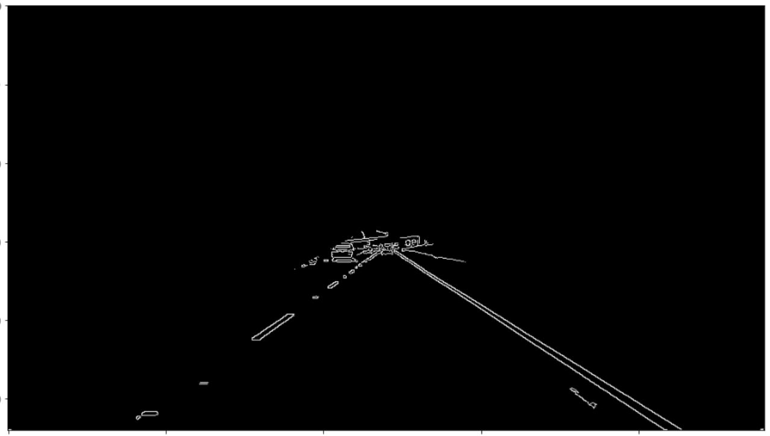
DETERMINE THE REGION

Slide 5
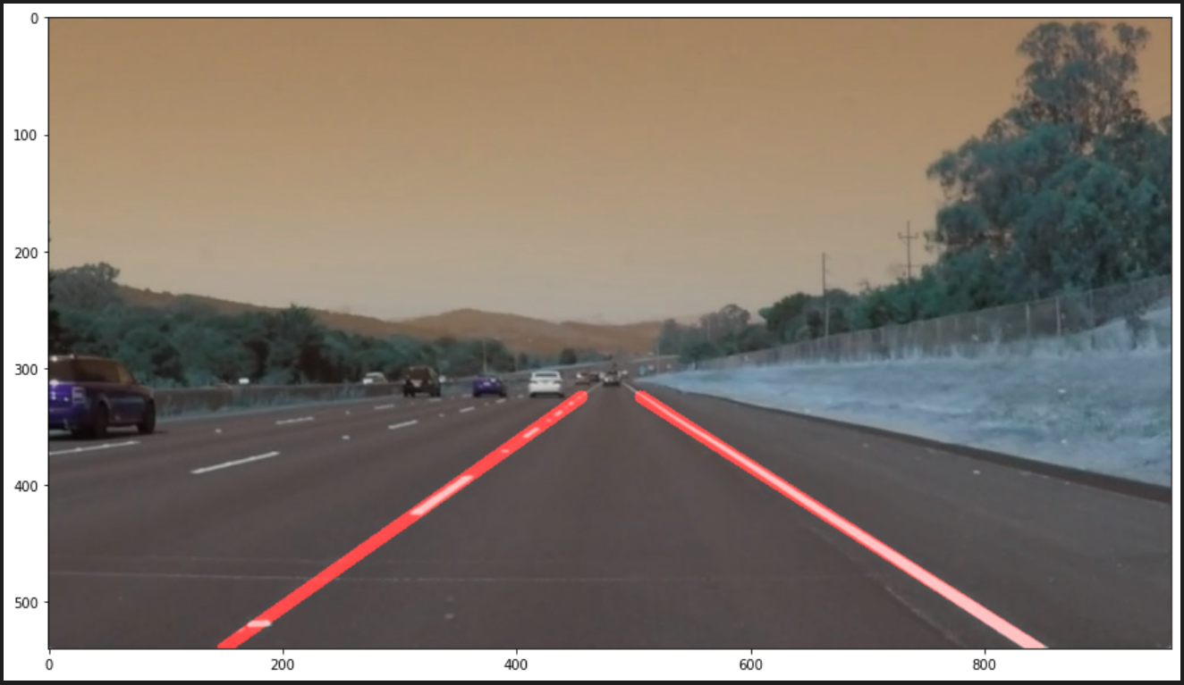
DETECT THE TWO LANES ON LEFT AND RIGHT

Slide 6
THANKYOU ☺

